Slide 1
Inequalities in primary school children’s engagement with remote schooling during the Spring 2020 Covid-19 lockdown in Ireland: Evidence from the Children’s School Lives study Dublin Economic Workshop, September 16th 2021
Yekaterina Chzhen (@kat_chzhen)
With Jennifer Symonds, Dympna Devine, Julia Mikolai, Susan Harkness, Seaneen Sloan & Gabriela Martinez Sainz

Slide 2
Timeline of COVID-19 pandemic in 2019-20 school year
February 28th, 2020
First confirmed case
May
CSL fieldwork starts
July
CSL fieldwork ends
March 13th
Schools close
June 30th
End of school year
September 2020
Schools re-open
Abrupt transition to remote schooling.
Warnings of learning loss and widening inequalities due to unequal access to learning resources and support with learning, as well as the economic impacts of the pandemic.

Slide 3
COVID-19 and children’s education: the story so far…
Stalled progress / learning loss (standardized assessments)
Belgium (Maldonado and De Witte, 2020).
Netherlands (Engzell et al, 2021).
United Kingdom (Renaissance Learning & Education Policy Institute, 2021).
Widening socio-economic inequalities in learning time
Germany (Dietrich et al, 2020).
Netherlands (Bol, 2020).
United Kingdom (Andrew et al, 2021; Bayrakdar & Guveli, 2020; Cattan et al, 2021; Eivers et al, 2020; Pensiero et al, 2020).

Slide 4
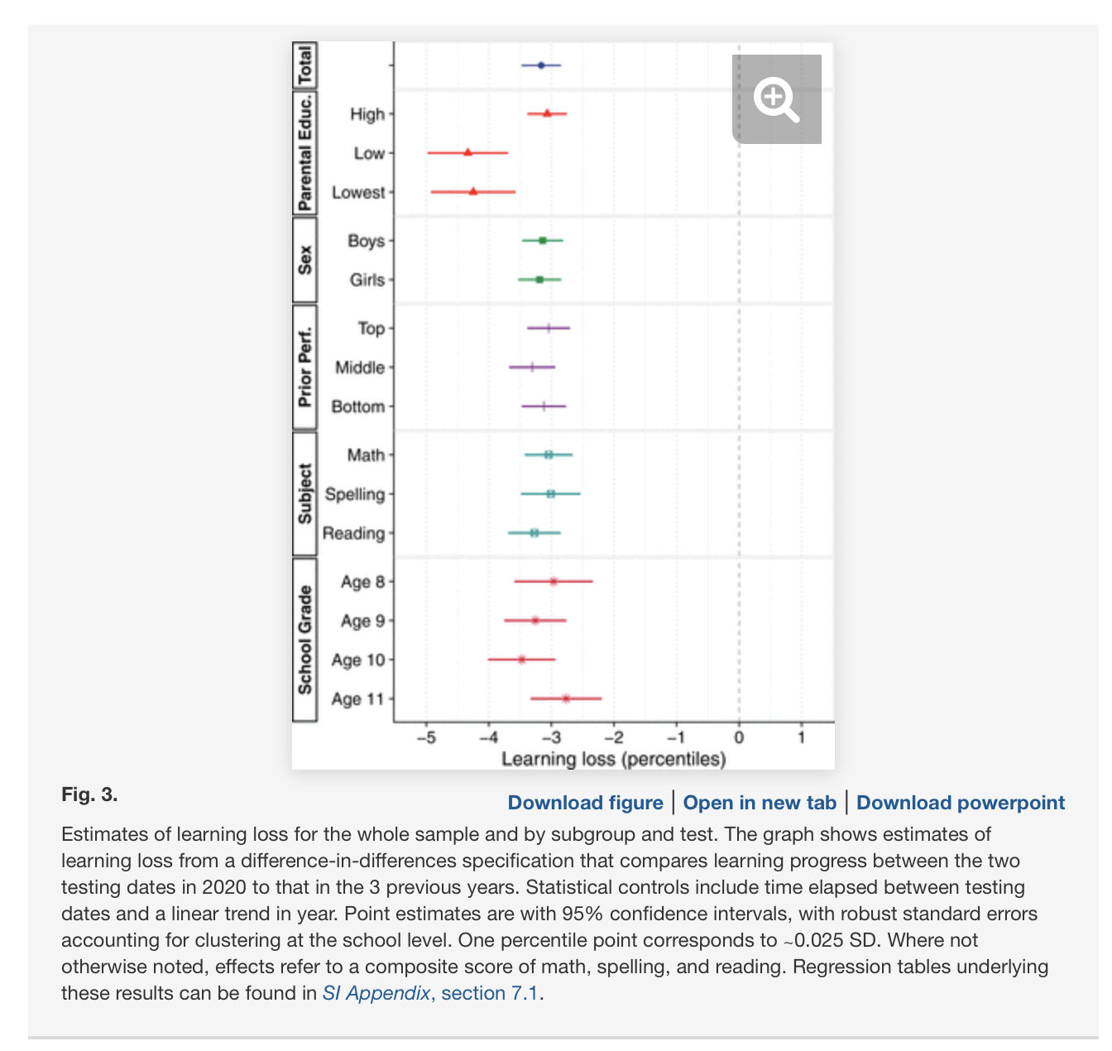
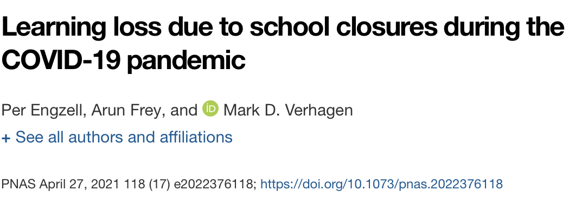
https://www.pnas.org/content/118/17/e2022376118

Slide 5
Research question and hypotheses
Does primary school children’s engagement in remote schooling during the Spring lockdown differ by family socio-economic status (SES) in Ireland?
We expect to observe higher levels of engagement with remote schooling in primary school children who:
H1: come from higher SES families.
H2: have better resources for remote learning.
H3: exhibited higher levels of engagement with schooling before the pandemic.

Slide 6
Data
Children’s School Lives (CSL) study (https://cslstudy.ie).
A nationally representative study of primary schools in Ireland, commissioned by the National Council for Curriculum and Assessment and conducted by the School of Education at University College Dublin.
Annual data collection (2019-2025).
Information from children, parents, teachers, and principals.
Cohort B: 8/9-olds (in 2019).
Wave 1 (”pre-COVID” May – July 2019; f2f) and Wave 2 (“Spring 2020 Lockdown” May – July 2020; online).

Slide 7
Measures
Engagement with remote schooling (Wave 2)
I look forward to home schooling;
I like doing home schooling;
I wish I didn’t have to do home schooling;
I like many things about home schooling;
Home schooling is interesting and fun.
Responses range from 1 “Never” to 5 “Always”.
Latent factor (mean 100, SD 10).
Socio-economic status (Wave 1)
Family affluence scale (cars, computers, family holidays, 0-7).

Slide 8
Measures
Resources for home learning (Wave 2)
Whether the child does their schoolwork on a computer/laptop at home, as opposed to on a tablet or smart phone (0/1).
“If I am worried about falling behind in home school, I can get help” (1-5).
“My work in home school is checked” (1-5).
Prior engagement with schooling (Teachers, Wave 1)
How often the child arrived at school without homework (Rarely/Never vs Sometimes/Always).
Controls (Wave 1)
Gender, language spoken at home, living with both parents (vs one parent), teacher-reported Strengths and Difficulties Questionnaire scores.

Slide 9
Sample
Wave 1: 2,000 children from across 100 schools.
Wave 2: 725 children from 89 schools; 540 responded.
Wave 1 + Wave 2 (complete cases): 376 children from 71 schools.
Participation in Wave 2 / analytic sample positively correlated with:
Living with both parents;
Higher Family Affluence Scale score;
Speaking English at home;
Coming to school with homework completed (wave 1);
Lower SDQ scores (Emotional Symptoms; Hyperactivity-Inattention).

Slide 10
Analysis
OLS regressions with school fixed effects.
Very little variation in school engagement due to between-school effects (ICC 1%).
Model 1: Family affluence scale + controls.
Model 2: + Resources for home learning.
Model 3: + Prior school engagement.

Slide 11
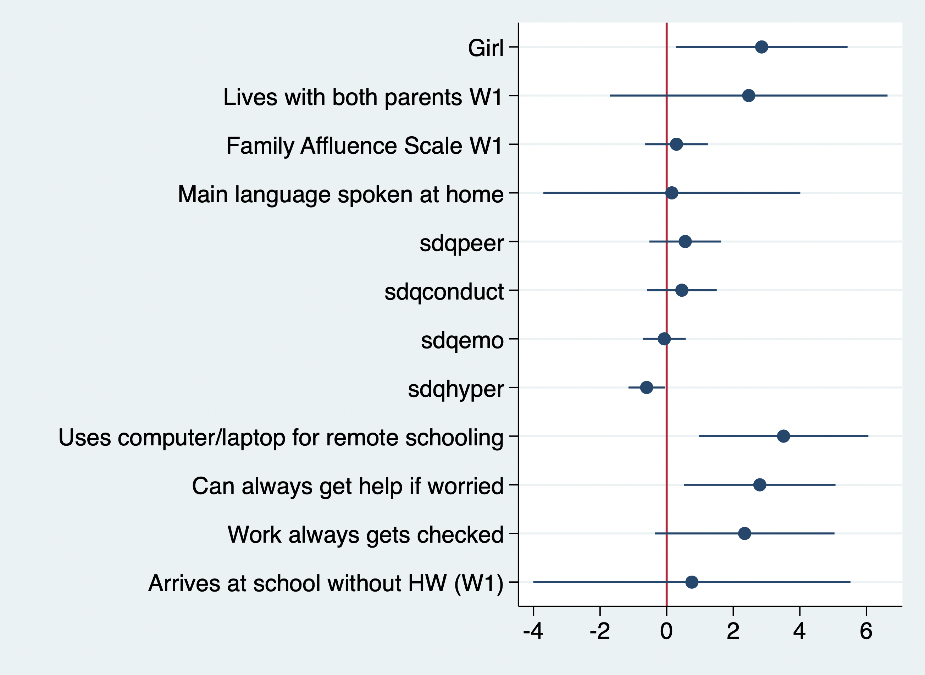
Results
Higher engagement is associated with (ceteris paribus):
Being a girl;
Lower hyperactivity scores;
Having a computer for remote schooling;
Access to help with remote schooling;

Slide 12
Key findings
The family affluence scale is not associated with remote schooling engagement.
Either on its own or controlling for other predictors.
Greater resources for remote learning are critical to higher engagement.
Digital resources.
Access to help (family and/or teachers).
Remote schooling disadvantages certain types of students (e.g. those with hyperactivity-inattention).

Slide 13
Bibliography
Andrew, A., Cattan, S., Dias, M. C., Farquharson, C., Kraftman, L., Krutikova, S., Phimister, A., & Sevilla, A. (2020). Inequalities in Children’s Experiences of Home Learning during the COVID-19 Lockdown in England. Fiscal Studies, 41(3), 653–683.
Armitage, R., & Nellums, L. B. (2020). Considering inequalities in the school closure response to COVID-19. The Lancet Global Health, 8(5), e644.
Bayrakdar, S., & Guveli, A. (2020). Inequalities in home learning and schools’ provision of distance teaching during school closure of COVID-19 lockdown in the UK. ISER Working Paper Series.
Bol, T. (2020). Inequality in homeschooling during the Corona crisis in the Netherlands. First results from the LISS Panel. Center for Open Science.
Cattan, S., Farquharson, C., Krutikova, S., Phimister, A., Salisbury, A., & Sevilla, A. (2021). Inequalities in responses to school closures over the course of the first COVID-19 lockdown. Institute for Fiscal Studies, WP, 21/04.
Dietrich, H., Patzina, A., & Lerche, A. (2020). Social inequality in the homeschooling efforts of German high school students during a school closing period. European Societies, 1–22.
Doyle, O. (2020). COVID-19: Exacerbating educational inequalities? Public Policy.
Engzell, P., Frey, A., & Verhagen, M. D. (2021). Learning loss due to school closures during the COVID-19 pandemic. Proceedings of the National Academy of Sciences, 118(17).
Eivers, E., Worth, J., & Ghosh, A. (2020). Home Learning during COVID-19: Findings from the Understanding Society Longitudinal Study. NFER.
in Remote Learning. National Foundation for Educational Research.
Maldonado, J. E., & De Witte, K. (2020). The effect of school closures on standardised student test outcomes. KU Leuven Department of Economics Discussion Paper DPS20, 17.
Pensiero, N., Kelly, A., & Bokhove, C. (2020). Learning inequalities during the Covid-19 pandemic: How families cope with home-schooling. University of Southampton.
Renaissance Learning, & Education Policy Institute. (2021b). Understanding progress in the 2020/21 academic year: Interim findings. Department for Education.

Slide 14
Thank you!

